Slide 1
Exploring Venues for a Swiss Restaurant in Zürich
Final Coursera Capstone Project

Slide 2
The city of Zürich
Zürich is the largest city in Switzerland with a population of over 428’700.1,4 million people live in the Zürich agglomeration.
By the end of 2018, 32% of the city's population was made up of non-Swiss from a total of 172 different countries.
6% of all foreigners who move to Switzerland come to the City of Zürich, emphasizing its central role as an economic hub.
The City of Zürich is divided into 12 districts and 34 quarters. The agglomeration of Zürich is made up of the City of Zürich and 130 other municipalities.

Slide 3
Business Problem
We want to support our stakeholders in finding the optimal location within the city where to open a new Swiss restaurant.
It is not so easy to decide on a venue for such a business: Swiss cuisine is not one of the most popular in the world, so we can expect that many tourists could be willing to try it out, but the large majority of the international population in the city may not be interested in going regularly to a Swiss restaurant.
We may presume that the majority of the existing Swiss restaurants are concentrated in the city centre and most touristic venues, to benefit from the influx of short term visitors.
It may then be a good option to look for venues with fewer existing restaurants, so not to be hindered by excessive competition, and with a higher percentage of local Swiss residents, so as to attract a clientele of national residents that are accustomed to the Swiss cuisine and may build up a base of regular and affectionate clients.
We will then be working with the 34 Zürich neighbourhoods and use the “Forsquare API” to build a venue data analysis and subsequently to cluster the various locations in order to identify the most promising places for a Swiss gastronomic business.

Slide 4
Data
List of the 34 Zürich neighbourhoods with their respective total population, number of Swiss residents and percentage of foreign inhabitants.
Python Geopy, used to get the coordinates for each of the Zürich neighbourhoods, in terms of latitude and longitude.
Foursquare API, which is instrumental to derive and populate the most common venues and location for each Zürich neighbourhood.

Slide 5
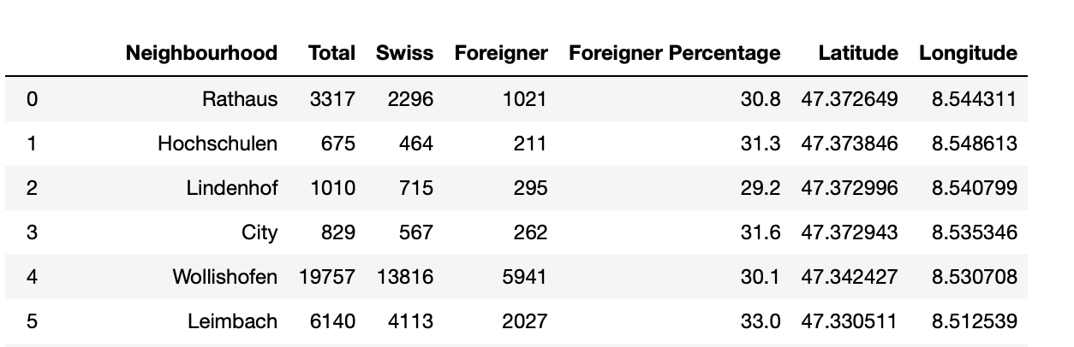
Inferential Statistical Analysis
We assemble the dataset containing the list of 34 neighbourhoods and for each of them the total population, the Swiss population, the foreign inhabitants and their percentage, together with the coordinates (longitude and latitude

Slide 6
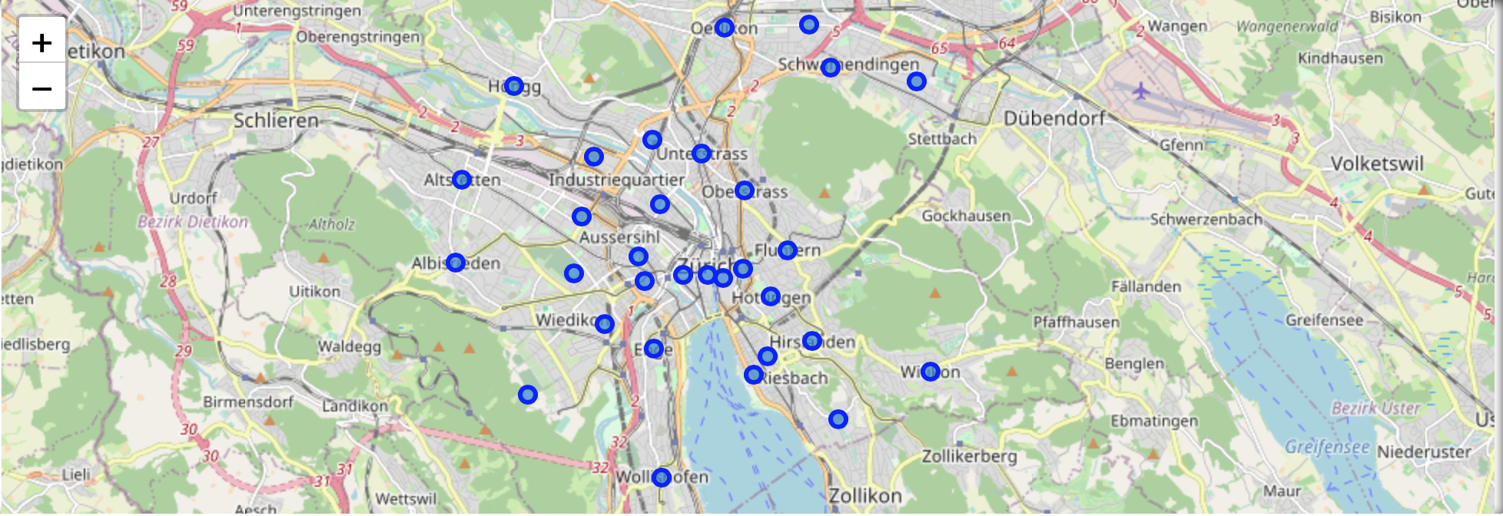
Neighbourhood Distribution around Zürich

Slide 7
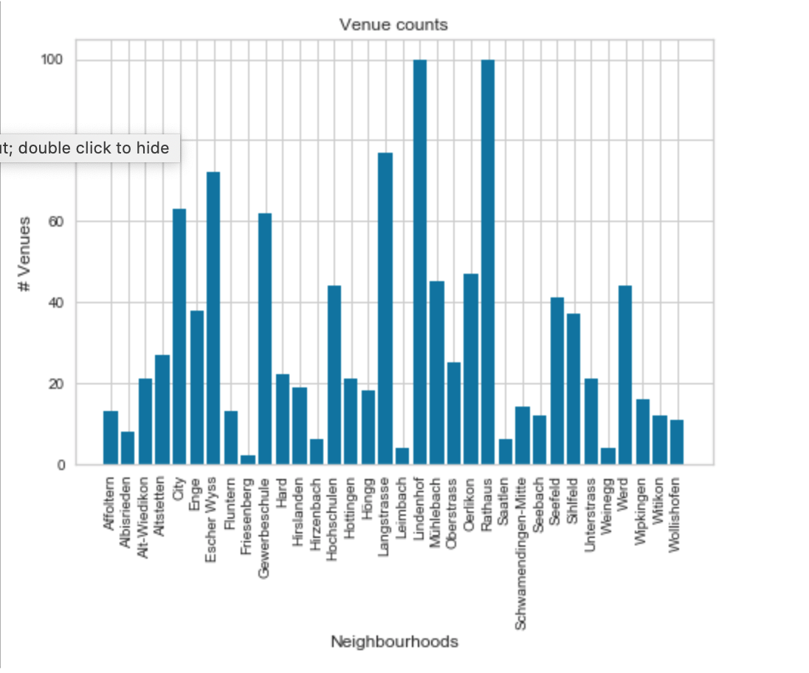
Venue Distribution for each Neighbourhood
With the help of Foursquare API we can now explore the venues associated to each neighbourhood, with a choice of radius of 500 m for each quartier.
We show here the counts of venues per neighbourhood

Slide 8
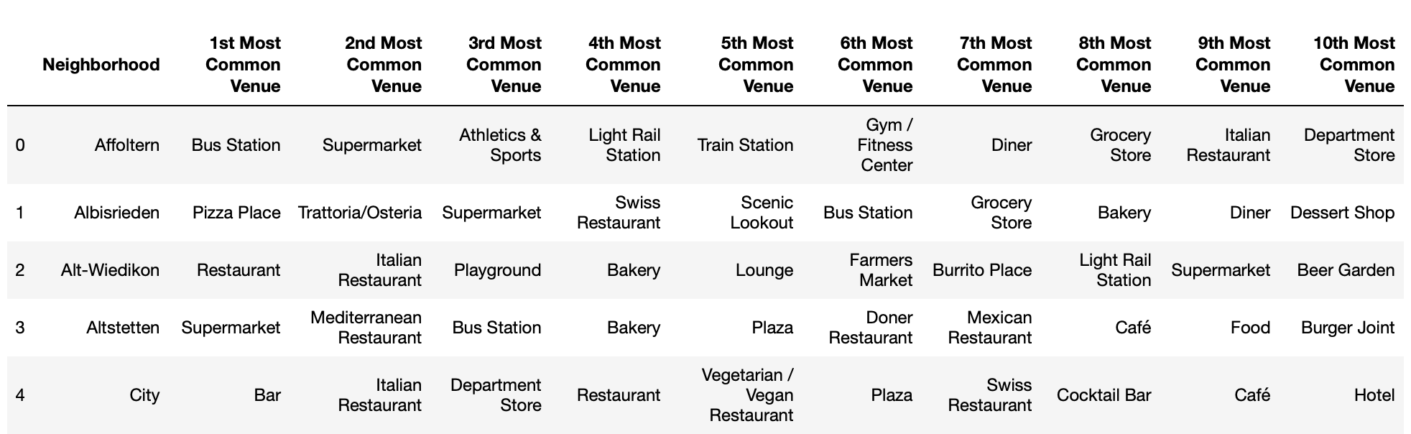
Most Common Venues
We identify the most common venues for each neighbourhood. This is also instrumental for our machine learning algorithm and for tackling our problem of finding the best location for a new Swiss restaurant.
We can already infer some interesting conclusions : central neighbourhoods like ‘City’ have a high concentration of gastronomic venues, while more peripheral places like ‘Affoltern’ do have instead a higher concentration of centres for leisure activities, like fitness centres, and more utility stores or stations.

Slide 9
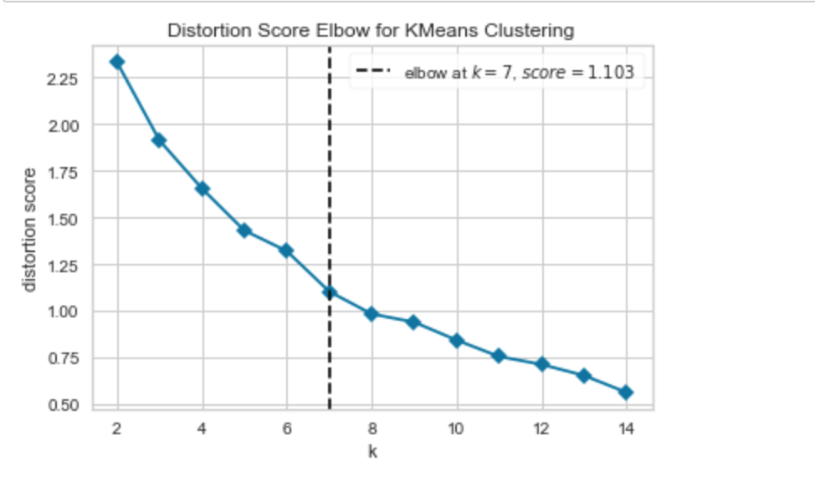
Machine Learning Analysis
We apply an unsupervised learning algorithm for clustering, K-Means.
We aim at identifying groups of venues that share characteristics in common. By grouping the different neighbourhoods in clusters, we may be able to identify if there is any particular set of locations which are more likely to be associated with restaurants or gastronomic businesses and therefore better suited for our new venture.
We start by performing an analysis to find out the optimal number of clusters by using the elbow algorithm.
In a range from 2 to 14, the optimal number of clusters is 7

Slide 10
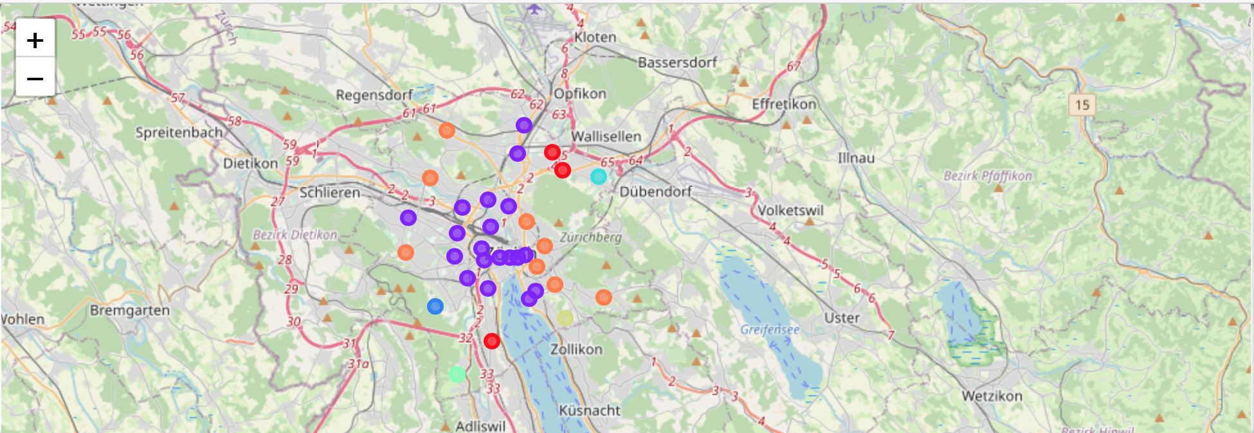
Clusters

Slide 11
Results
From our clusters we can infer that the best location for a new Swiss restaurant would be in the second cluster (violet blobs), the bars and restaurants area.
We want to focus on a more national clientele and avoid neighbourhoods which are already crowded with Swiss restaurants for tourists. Therefore, we search among the neighbourhoods in the second cluster those which fulfil the following conditions:
there are no existing Swiss restaurants among the top ten venues;
there is the lowest percentage of foreign inhabitants, so as to have better chances to attract Swiss customers who already know and grew up with this cuisine.
Wipkingen is a good candidate for our client: it lies in the “Restaurant cluster”, it does not have yet many Swiss restaurants (this venue does not figure in the top ten) and the percentage of foreign inhabitants is relatively low, 27%
Wipkingen is also quite centrally located and it occupies that part of the city which is most in development (“Kreis 5”), with modern new buildings and a growing population. We can therefore reinforce our suggestion also based on these considerations.

Slide 12
Discussion
Despite our promising conclusion, there are some limitations to our analysis and possible extensions that could potentially make our conclusions more robust.
We used the population data for 2020 only, a more sophisticated approach could build a predictive model on how the population is going to evolve in the future.
Do we expect a growing immigration in the city?
From which nationality groups and concentrated in which neighbourhoods?
Answering this questions could help further analysing the ethnic diversity of Zürich and possibly identifying restaurant venues for different types of cuisines based on how diverse/international a neighbourhood is.
We could consider a wider range of neighbourhoods and sub- neighbourhoods, by dividing each quartier into its subdivisions or by extending to the greater Zürich area
We could then analyse a wider distribution of venues and possibly have a better statistical basis to conclude on where, within and around Zürich, a business could be more successful.

